Slide 1
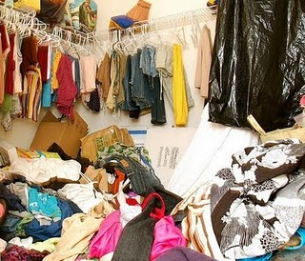
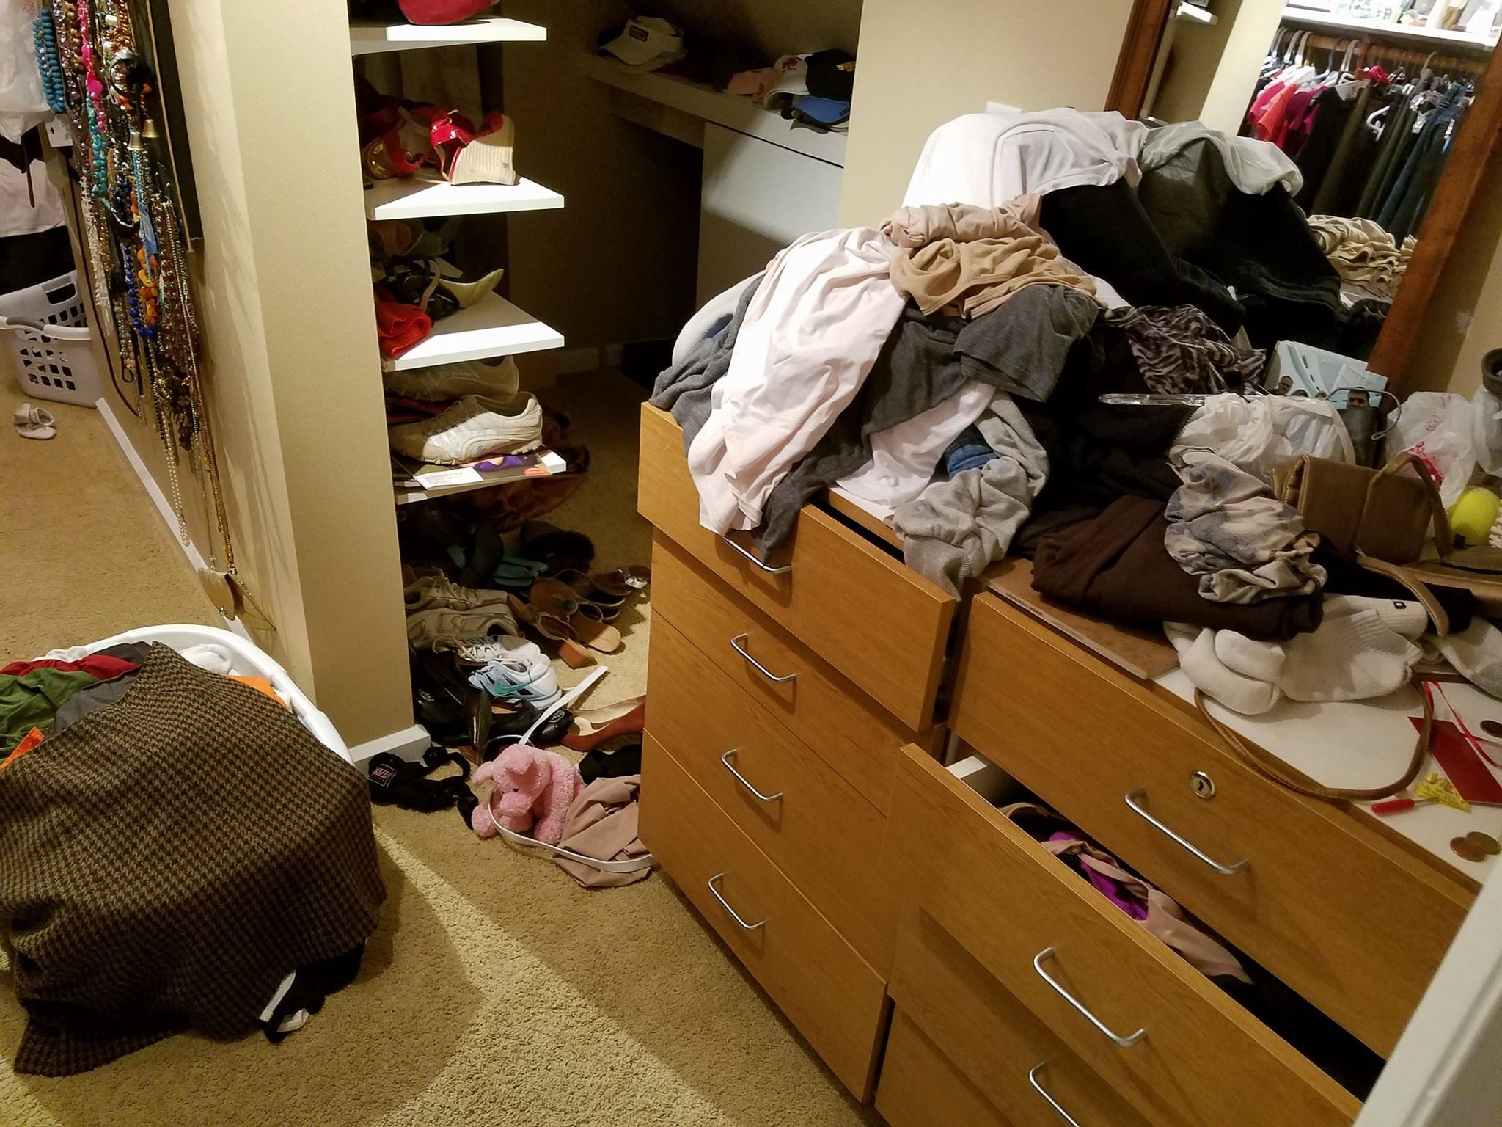
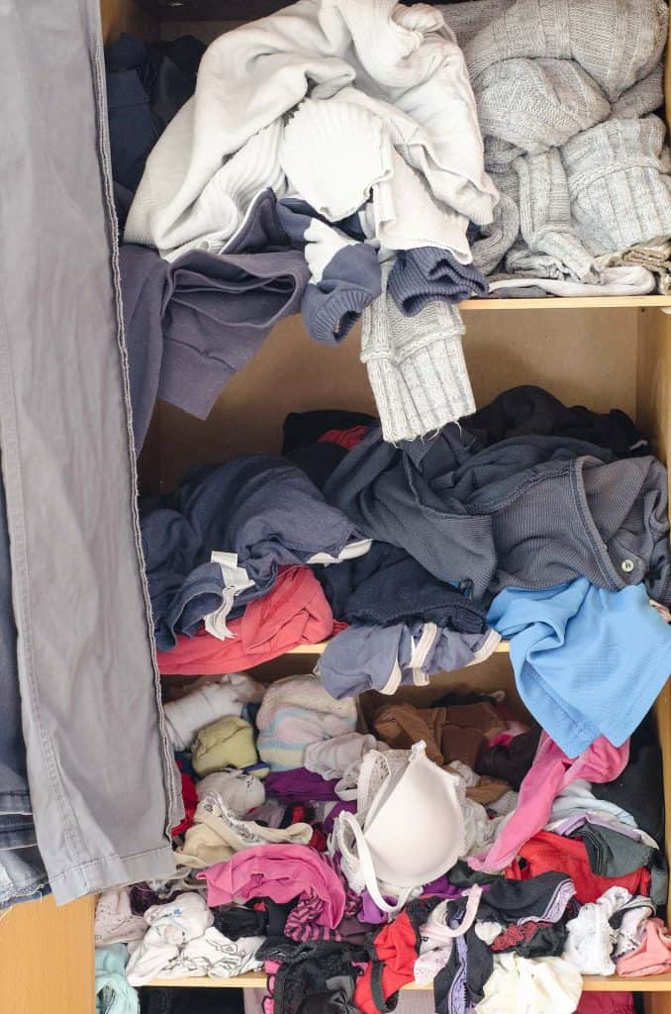
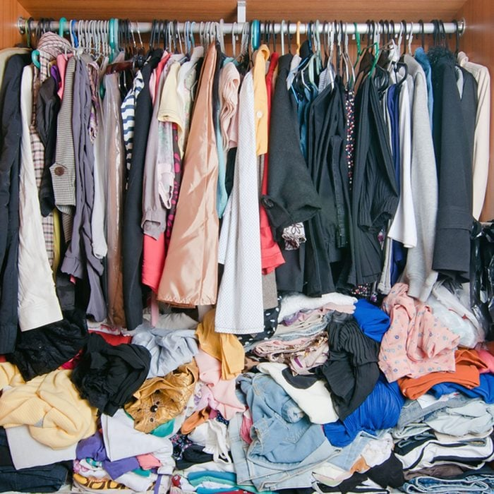
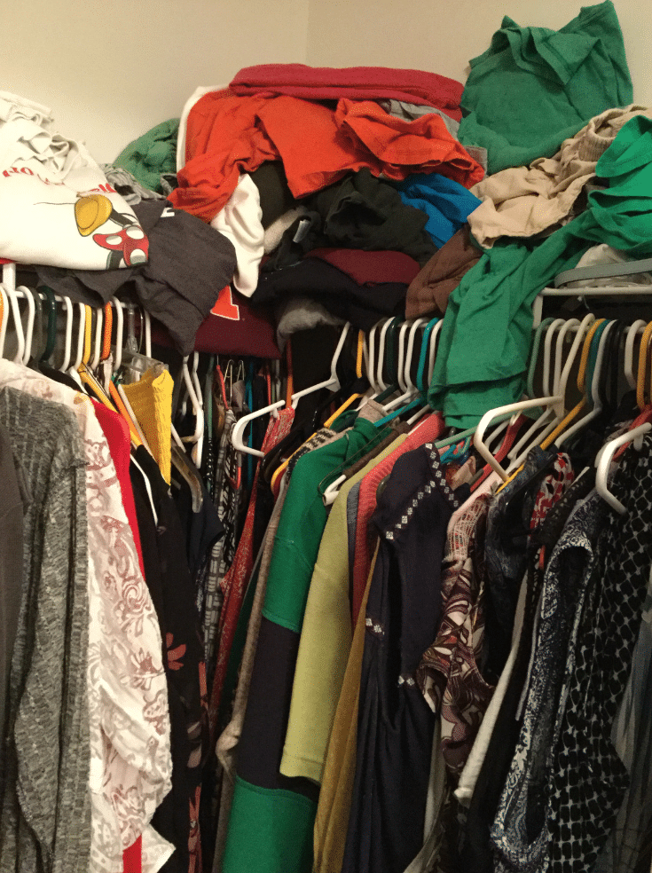

Slide 2
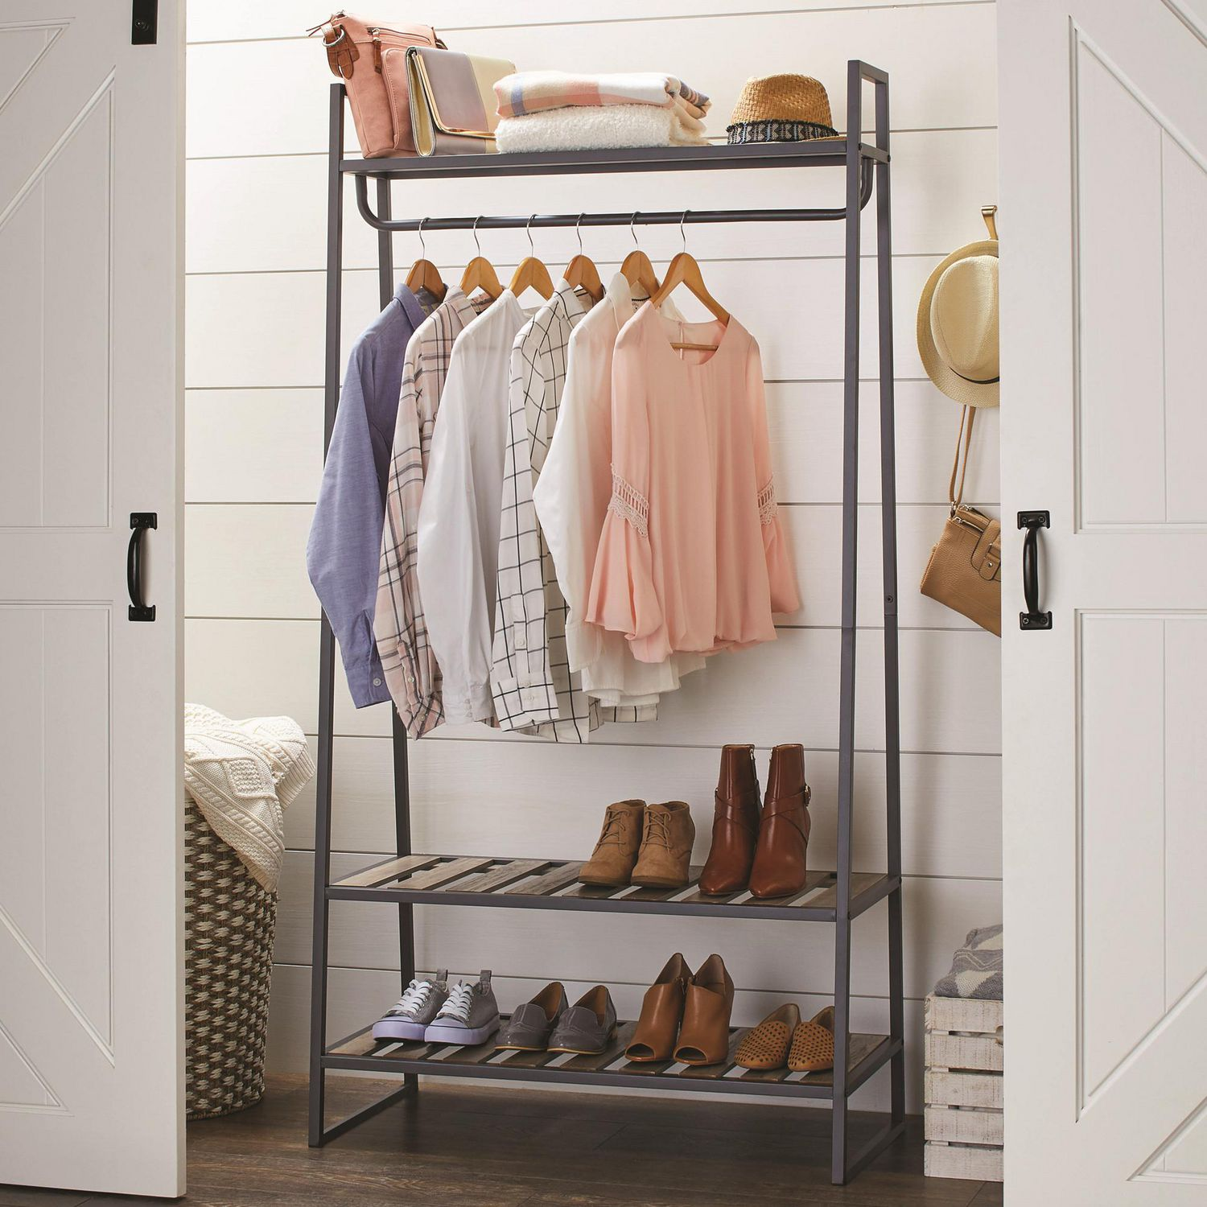
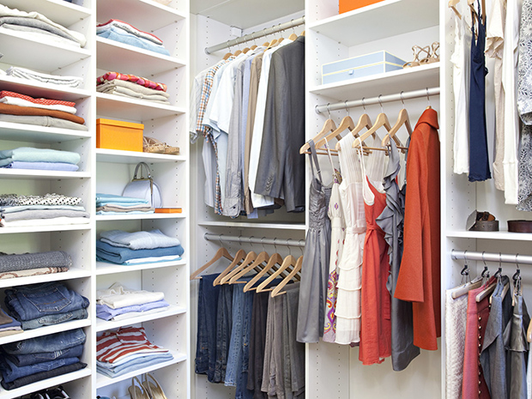

Slide 3
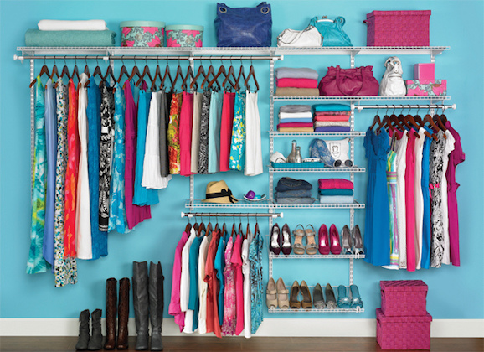

Slide 4


Slide 5


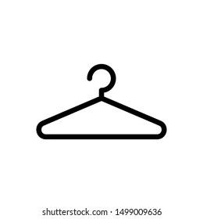

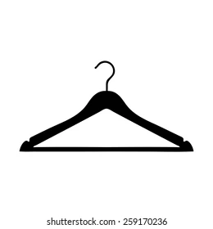





Slide 6




Rack
Rack
Brand Logo
Mobile App Icons
#FF5757 Coral Red
Scrapped App Icons
SAVE: Original Logo Layout

Slide 7
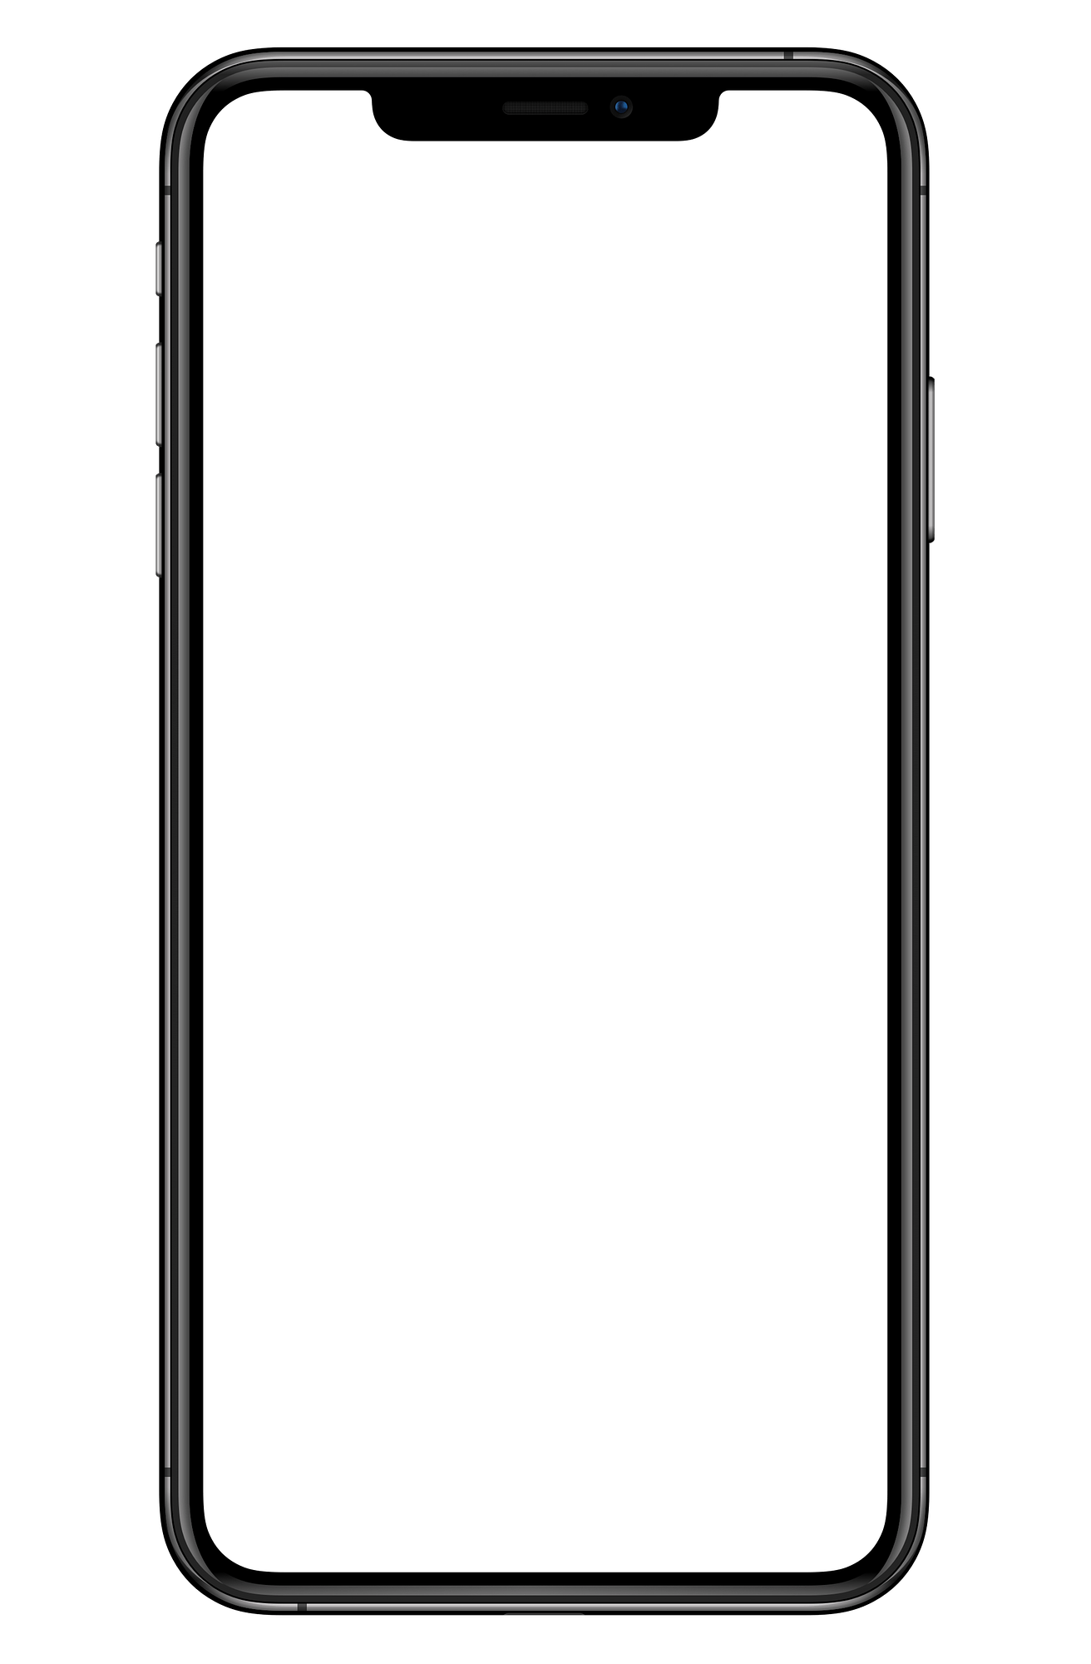



8:42
8:42
8:42
What’s in your closet?
What’s on your
What’s in your closet?
What’s on your
What’s in your closet?
What’s on your
Log In
Log In
Log In
Sign Up
Sign Up
Sign Up
Powered by Paula Anderson
Powered by Paula Anderson
Powered by Paula Anderson

Slide 8








8:42
8:42
8:42
{{ FirstName }}, your latest Rack Stats await!
Good {{ TimeOfDay }}, {{ FirstName }}!
User Profile
Quick Rack: Opens camera and adds image to “Add New Rack” Form
App Settings
Another day, another outfit!
{{ Season }} clothes are your largest Rack category!
Home:
Planet icon instead of house for fresh modern vibe
Outfit Builder
Coming Soon!
User’s Closet Inventory
You have more
{{ GreaterType }} than
{{ LesserType }}!
Rack
Stats
My Wish Rack
Home
My Rack
Build
Home
My Rack
Build
Home
My Rack
Build

Slide 9







8:42
8:42
8:42
Search
Search
Search
Filter
Filter
Filter
Save search
option
Save search
option
Save search
option
Browse All
Browse All
Browse All
By Season
By Type
By Season
By Type
By Season
By Type
New
Rack Item
New
Rack Item
New
Rack Item
Coming Soon!
Coming Soon!
Coming Soon!
By Color
By Style
By Color
By Style
By Color
By Style
Home
My Rack
Build
Home
My Rack
Build
Home
My Rack
Build

Slide 10


8:42
8:42
8:42
Outfit Builder
Outfit Builder
Outfit Builder
{{ FirstName }} X RACK Collab
{{ FirstName }} X RACK Collab
{{ FirstName }} X RACK Collab
Start
Start
Start
Home
My Rack
Build
Home
My Rack
Build
Home
My Rack
Build

Slide 11
add builder form mockup
add new rack form mockup
add search view

Slide 12

Rack Database Schema
MVP
Backburner work
Users
User_id | INT
FirstName | VARCHAR
LastName | VARCHAR
Email | VARCHAR
Birthday | DATETIME
Gender | ENUM
Signup_date | DATETIME
User_img
Email_status | ENUM
User_Racks
User_id | INT
Item_id | INT
Item_img
Season | ENUM
Type | ENUM
Color_id | INT
User_Rack_Searches
User_id | INT
Search_id | INT
Season | ENUM
Type | ENUM
Color_id | INT
User_Outfits
User_id | INT
Outfit_id | INT
Generated? | INT SIZE 1
Item_id_1 | INT
Item_id_2 | INT
Item_id_3 | INT
Clothing_Types
Type_id | INT
Type | ENUM
Clothing_Colors
Color_id | INT
Color | VARCHAR

Slide 13
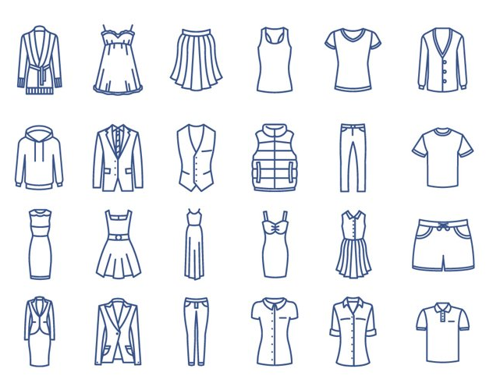
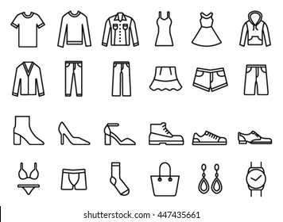

Slide 14
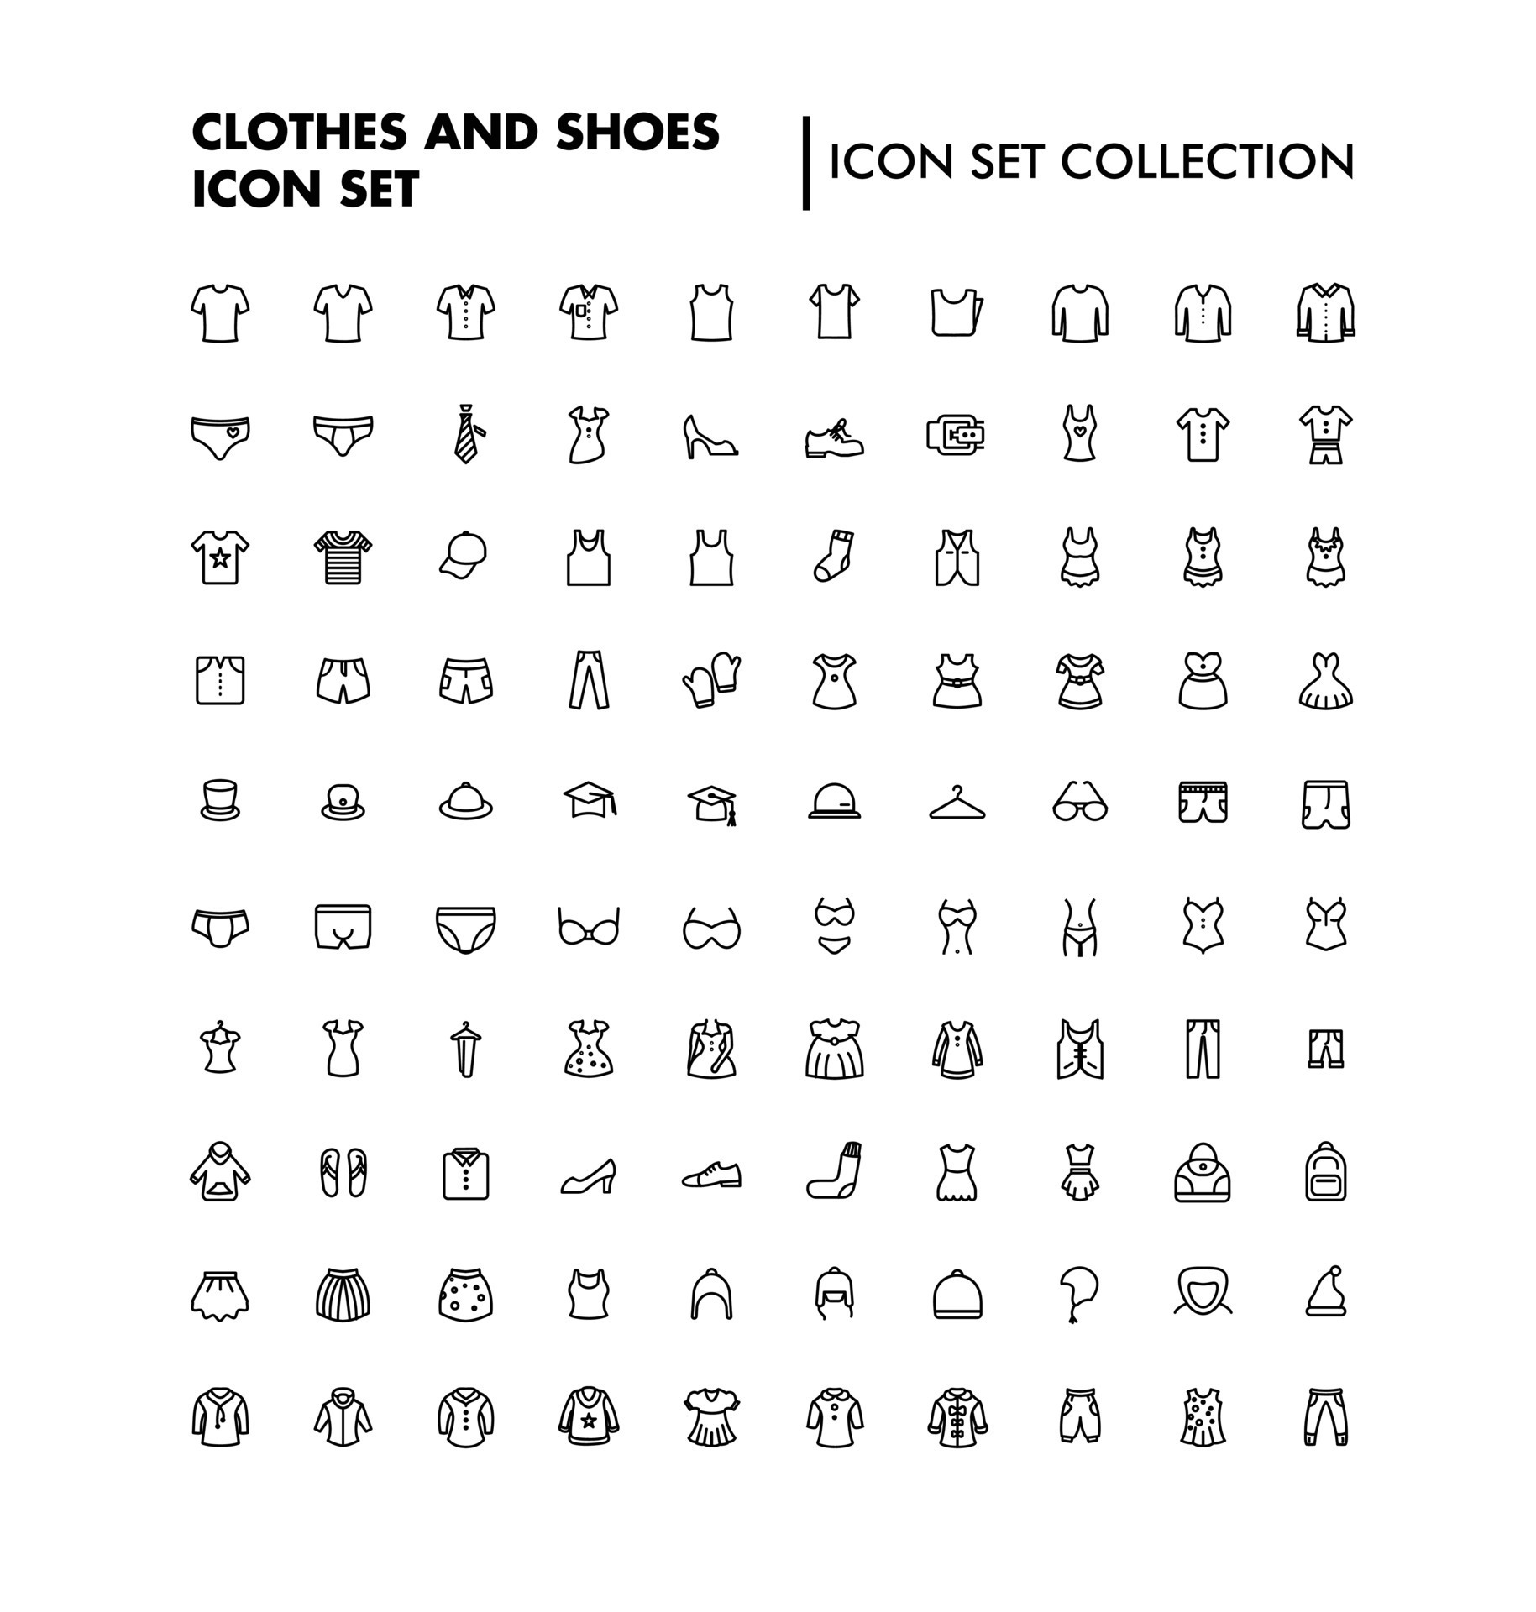

Slide 15
